Slide 1
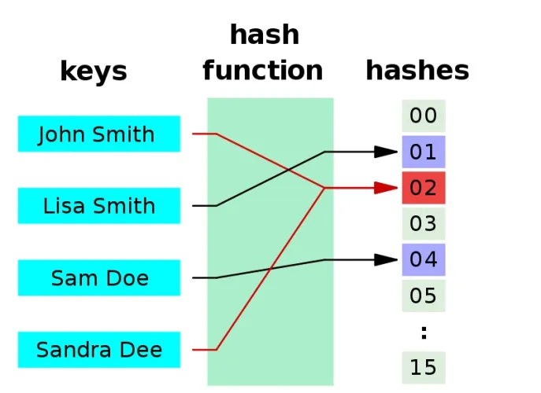
Hashing

Slide 2
Hashing is a technique that is used to uniquely identify a specific object from a group of similar objects
Assume that you have an object and you want to assign a key to it to make searching easy.
To store the key/value pair, you can use a simple array like a data structure where keys (integers) can be used directly as an index to store values.
However, in cases where the keys are large and cannot be used directly as an index, you should use hashing.
In hashing, large keys are converted into small keys by using hash functions.
The values are then stored in a data structure called hash table.
The idea of hashing is to distribute entries (key/value pairs) uniformly across an array.

Slide 3
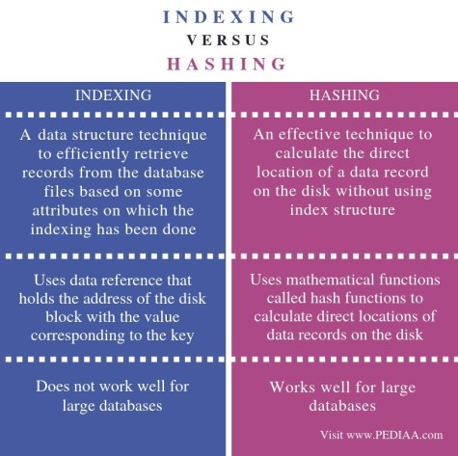
The main difference between indexing and hashing is that
the indexing optimizes the performance of a database by reducing the number of disk accesses to process queries
while hashing calculates the direct location of a data record on the disk without using index structure.

Slide 4
Hashing is implemented in two steps:
An element is converted into an integer by using a hash function.
This element it can then be used as an index to store the original element, which falls into the hash table.
The element is stored in the hash table where it can be quickly retrieved using hashed key.
hash = hashfunc(key)
index = hash % array_size
In this method, the hash is independent of the array size and it is then reduced to an index (a number between 0 and array_size − 1) by using the modulo operator (%).

Slide 5
Hash function
A hash function is any function that can be used to map a data set of an arbitrary size to a data set of a fixed size, which falls into the hash table. The values returned by a hash function are called hash values, hash codes, hash sums, or simply hashes.
Good hash function has following basic requirements:
Easy to compute: It should be easy to compute and must not become an algorithm in itself.
Uniform distribution: It should provide a uniform distribution across the hash table and should not result in clustering.
Less collisions: Collisions occur when pairs of elements are mapped to the same hash value, collision should be avoided.
Note: Irrespective of how good a hash function is, collisions are bound to occur.

Slide 6
Hash table
A hash table is a data structure that is used to store keys/value pairs.
It uses a hash function to compute an index into an array in which an element will be inserted or searched.
Hashing work well by using a good hash function
Under reasonable assumptions, the average time required to search for an element in a hash table is O(1).

Slide 7
Division method
In this method,
key k to be mapped into one of the m slots in the hash table.
The key is divided by m and the remainder of the division is taken as index of the hash table
The hash function is defined as
h(k) = k mod m
Example
Consider hash table with 9 slots. To which slot key=132 will map to ?
Using h(k) = k mod m
h(132) = 132 mod 9 = 6
Note – In division method, certain values of m should be avoided, preferable values for m are prime numbers and not too close to exact powers of 2

Slide 8
Multiplication Method
This method operates in two steps .
Step1- the key value is multiplied by constant A in the range 0<A<1 and abstract the fractional part of value kA
Step2- the fractional value obtained is then multiplied by m and the floor of the result is taken as the hash value
Thus h(k) = floor (m (kA mod 1))
(Knuth suggested the efficient value for A as 0.6180339887)
Example – Consider a hash table with 1000 slots, then key= 123456 will map to which slot ?
h(123456) = floor (1000 (123456 x 0.61803 mod 1)) = floor (41.151 ) = 41
(123456 x 0.61803 = 76300.0041151)
Example – Consider a hash table with 300 slots, then key= 3456 will map to which slot ?
185

Slide 9
Folding Method
It is performed in two step
Step1- the key value is divided into number of parts say k1,k2,k3…..kr, where each part has same number of digits except the last part (which can have lesser digits)
Step2- these parts are added together and the hash value is obtained by ignoring the last carry.
Ex – Consider a hash table with 100 slots and key values are 9235, 714, 71458
k | 9235 | 714 | 71458
Parts | 92 , 35 | 71, 4
Sum | 127 | 75
h(k) | 27 | 75

Slide 10
Folding Method
It is performed in two step
Step1- the key value is divided into number of parts say k1,k2,k3…..kr, where each part has same number of digits except the last part (which can have lesser digits)
Step2- these parts are added together and the hash value is obtained by ignoring the last carry.
Ex – Consider a hash table with 100 slots and key values are 9235, 714, 71458
k | 9235 | 714 | 71458
Parts | 92 , 35 | 71, 4 | 71, 45, 8
Sum | 127 | 75 | 124
h(k) | 27 | 75 | 24

Slide 11
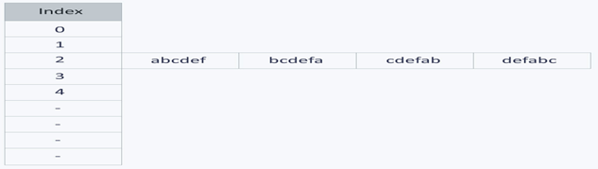
Need for a good hash function
Let us understand the need for a good hash function. Assume that we have to store strings in the hash table by using the hashing technique
{“abcdef”, “bcdefa”, “cdefab” , “defabc” }.
To compute the index for storing the strings,
We use a hash function that states the following:
The index for a specific string will be equal to the sum of the ASCII values of the characters modulo 599.
The ASCII values of
a, b, c, d, e, and f are
97, 98, 99, 100, 101, and 102 respectively
The hash function will compute the same index for all the strings and the strings will be stored in the hash table

Slide 12
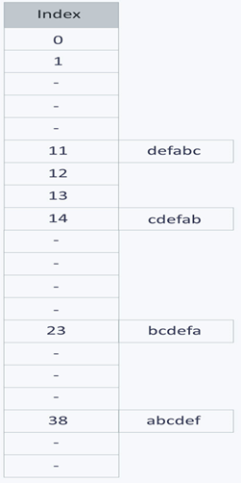
Proposing a good Hash Function
Let’s try a different hash function.
The index for a specific string will be equal to sum of ASCII values of characters multiplied by their respective order in the string after which it is modulo with 2069 (prime number).
String Hash function Index abcdef (97*1 + 98*2 + 99*3 + 100*4 + 101*5 + 102*6)%2069 38
bcdefa (98*1 + 99*2 + 100*3 + 101*4 + 102*5 + 97*6)%2069 23
cdefab (99*1 + 100*2 + 101*3 + 102*4 + 97*5 + 98*6)%2069 14
defabc (100*1 + 101*2 + 1023 + 97*4 + 98*5 + 99*6)%2069 11
The ASCII values of
a, b, c, d, e, and f are
97, 98, 99, 100, 101, and 102 respectively

Slide 13
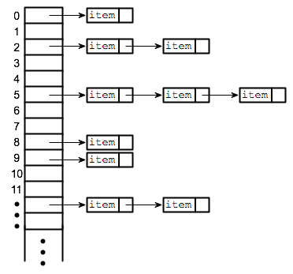
Collision resolution techniques
Separate chaining (open hashing)
It is one of the most commonly used collision resolution techniques. It is usually implemented using linked lists.
In separate chaining, each element of the hash table is a linked list.
To store an element in the hash table we insert it into a specific linked list.
If there is any collision (i.e. two different elements have same hash value) then store both the elements in the same linked list.

Slide 14
Ex Separate chaining (open hashing)
Consider the insertion of elements
5, 28, 19, 15, 20, 33, 12, 17, 10
into a chained-hash-table with 9 slots. The table uses the following hash function
h(k) = k mod 9
Soln – elements are inserted as
h(5) = 5 mod 9 = 5
h(28) = 28 mod 9 = 1
h(19) = 19 mod 9 = 1
h(15) = 15 mod 9 = 6
h(20) = 20 mod 9 = 2
h(33) = 33 mod 9 = 6
h(12) = 12 mod 9 = 3
h(17) = 17 mod 9 = 8
Elements are inserted in beginning to keep O(1)
0 | X
1 | X
2 | X
3 | X
4 | X
5 | X
6 | X
7 | X
8 | X

Slide 15
insert elements using Separate chaining (open hashing) 15, 28, 29, 15, 20,
into a chained-hash-table with 6 slots.
The table uses the following hash function
h(k) = k mod 6
Soln – elements are inserted as
0 | X
1 | X
2 | X
3 | X
4 | X
5 | X

Slide 16
Linear probing (open addressing or closed hashing)
Probing – the process of examining the slots in the hash table
"open addressing" refers to the fact that the location or address of the item is not determined by its hash value.
In open addressing, instead of in linked lists, all entry records are stored in the array itself.
When a new entry has to be inserted
the hash index of the hashed value is computed and then the array is examined (starting with the hashed index).
If the slot at the hashed index is unoccupied, then the entry record is inserted in slot at the hashed index
else it proceeds in some probe sequence until it finds an unoccupied slot.
Probe sequence is the sequence that is followed while traversing through entries.
In different probe sequences, we have different intervals between successive entry slots or probes.

Slide 17
When searching for an entry
the array is scanned in the same sequence until either the target element is found or an unused slot is found.
unused slot indicates that there is no such key in the table.
In Linear probing the interval between successive probes is fixed (usually to 1).
Ex linear probing uses the following hash function
h(k, i) = [h’(k) + i ] mod m
Here m is the size of the hash table
h’(k) = k mod m ( hash fns)
i will range from 0 to m-1
Alternatively
Let’s assume that the hashed index for a particular entry is index.
The probing sequence for linear probing will be:
index = index % hashTableSize index = (index + 1) % hashTableSize index = (index + 2) % hashTableSize index = (index + 3) % hashTableSize

Slide 18
Consider inserting the keys 76, 26, 37, 59 into hash table of size m =11 using liner probing .
Use hash function h’(k) = k mod m
Solution
using h(k,i) = [h’(k) + i ] mod m
Key k =76
h(76,0)= (76 mod 11 + 0)mod 11 = (10 + 0) mod 11 = 10 mod 11 = 10 (empty)
Key k = 26
h(26,0)= (26 mod 11 + 0)mod 11 = (4 + 0) mod 11 = 4 mod 11 = 4 (empty)
Key k = 37
h(37,0)= (37 mod 11 + 0)mod 11 = (4 + 0) mod 11 = 4 mod 11 = 4 (occupied)
Finding next probe sequence
h(37,1)= (37 mod 11 + 1)mod 11 = (4 + 1) mod 11 = 5 mod 11 = 5 (empty)
Key k = 59
h(59,0)= (59 mod 11 + 0)mod 11 = (4 + 0) mod 11 = 4 mod 11 = 4 (occupied)
Finding next probe sequence
h(59,1)= (59 mod 11 + 1)mod 11 = (4 + 1) mod 11 = 5 mod 11 = 5 (occupied)
Finding next probe sequence
h(59,2)= (59 mod 11 + 2)mod 11 = (4 + 2) mod 11 = 6 mod 11 = 6 (empty)

Slide 19
Quadratic Probing
Linear probing is easy to implement but it suffers from primary clustering
Cluster means block of occupied slots
Primary clustering refers many such blocks separated by free slots
It increases number of probes to find a free slot
Quadratic probing is similar to linear probing and the only difference is the interval between successive probes or entry slots.
Quadratic Probe uses the following hash function
h(k, i) =[h’(k)]+c₁i + c₂ i²] mod m
Here m is the size of the hash table
h’(k) = k mod m ( hash fns)
c₁ and c₂ are constants not equal 0
i is probe number

Slide 20
In Quadratic probing
when the slot at a hashed index for an entry record is already occupied, we start traversing until you find an unoccupied slot.
The interval between slots is computed by adding the successive value of an arbitrary polynomial in the original hashed index.
Let us assume that the hashed index for an entry is index and at index there is an occupied slot.
The probe sequence will be as follows:
index = index % hashTableSize index = (index + 1²) % hashTableSize index = (index + 2²) % hashTableSize index = (index + 3²) % hashTableSize
and so on…

Slide 21
Consider inserting the keys 76, 26, 37, 59 into hash table of size m =11 using quadratic probing . [given c1= 1 and c2=3]
Use hash function h’(k) = k mod m
Solution
using h(k, i) =[h’(k)]+c₁i + c₂i²] mod m = [ k mod 11 + 1xi + 3x i²] mod 11
Key k =76
h(76,0)= [ 76 mod 11 + 0 + 3 x 0] mod 11 = (10 + 0 + 0) mod 11 = 10 mod 11 = 10 (empty)
Key k = 26
h(26,0)= [ 26 mod 11 + 0 + 3 x 0] mod 11 = (4 + 0 + 0) mod 11 = 4 mod 11 = 4 (empty)
Key k = 37
h(37,0)= [ 37 mod 11 + 0 + 3 x 0] mod 11 = (4 + 0 + 0) mod 11 = 4 mod 11 = 4 (occupied)
Finding next probe sequence
h(37,1)= [ 37 mod 11 + 1 + 3 x 1] mod 11 = (4 + 1 + 3) mod 11 = 8 mod 11 = 8 (empty)
Key k = 59
h(59,0)= [ 59 mod 11 + 0 + 3 x 0] mod 11 = (4 + 0 + 0) mod 11 = 4 mod 11 = 4 (occupied)
Finding next probe sequence
h(59,1)= [ 59 mod 11 + 1 + 3 x 1] mod 11 = (4 + 1 + 3) mod 11 = 8 mod 11 = 8 (occupied)
Finding next probe sequence
h(59,2)= [ 59 mod 11 + 2 + 3 x 4] mod 11 = (4 + 2 + 12) mod 11 = 18 mod 11 = 7 (empty)

Slide 22
Double hashing
Double hashing is similar to linear probing and the only difference is the interval between successive probes.
Here, the interval between probes is computed by using two hash functions.
Lets linear probing uses the following hash function
h(k,i) = [h₁(k) + i.h₂(k) ] mod m
Here m is the size of the hash table
h₁(k) = k mod m ( hash fns)
h₂(k) = k mod m’ [hash fns with slightly less m (say m-1)]
i is 0 to m-1

Slide 23
Consider inserting the keys 76, 26, 37, 59 into hash table of size m =11 using double hashing.
Use hash function h1(k) = k mod 11 and h2(k) = k mod 9
Solution
using h(k,i) = [h₁(k) + i.h₂(k) ] mod m
Key k =76
h1(76)= (76 mod 11) =10 and h2(76) = 76 mod 9 = 4
h(76,0) = (10 + 0 x 4 ) mod 11 = 10 mod 11 = 10 (empty)
Key k = 26
h1(26)= (26 mod 11) =4 and h2(26) = 26 mod 9 = 8
h(26,0) = (4 + 0 x 8 ) mod 11 = 4 mod 11 = 4 (empty)
Key k = 37
h1(37)= (37 mod 11) =4 and h2(37) = 37 mod 9 = 1
h(37,0) = (4 + 0 x 1 ) mod 11 = 4 mod 11 = 4 (occupied)
Finding next probe sequence
h(37,1)= (4 + 1 x1 ) mod 11 = 5 mod 11 =5 (empty)

Slide 24
Consider inserting the keys 76, 26, 37, 59 into hash table of size m =11 using double hashing.
Use hash function h1(k) = k mod 11 and h2(k) = k mod 9
Solution
using h(k,i) = [h₁(k) + i.h₂(k) ] mod m
Key k =76
h1(76)= (76 mod 11) =10 and h2(76) = 76 mod 9 = 4
h(76,0) = (10 + 0 x 4 ) mod 11 = 10 mod 11 = 10 (empty)

Slide 25
Applications
Associative arrays: Hash tables are commonly used to implement many types of in-memory tables. They are used to implement associative arrays (arrays whose indices are arbitrary strings or other complicated objects).
Database indexing: Hash tables may also be used as disk-based data structures and database indices (such as in dbm).
Caches: Hash tables can be used to implement caches i.e. auxiliary data tables that are used to speed up the access to data, which is primarily stored in slower media.
Object representation: Several dynamic languages, such as Perl, Python, JavaScript, and Ruby use hash tables to implement objects.
Hash Functions are used in various algorithms to make their computing faster

